Slide 1


OBJECT DETECTION IN IMAGES USING CNNs
S CHETHNA
192225006

Slide 2
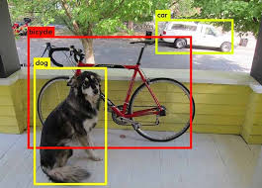
INTRODUCTION
Object detection in images using Convolutional Neural Networks (CNNs) involves training a model to identify and locate specific objects within an image.
CNNs excel at extracting relevant features from images, enabling them to recognize patterns and classify objects accurately.
By combining this feature extraction capability with techniques like region proposals and bounding box regression, object detection models can precisely pinpoint the location and category of objects in complex scenes.
Applications such as autonomous vehicles, image search, and surveillance systems.

Slide 3







ENVIRONMENTAL SETUP
HARDWARE REQUIREMENTS:
CPU
RAM
GPU
SOFTWARE REQUIREMENTS:
Python interpreter
DEEP LEARNING FRAMEWORKS:
TensorFlow, PyTorch, Keras
TOOLS:
Jupyter Notebook
Open CV

Slide 4
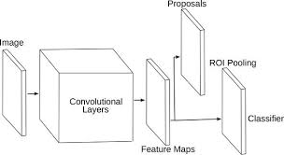
ARCHITECTURE DIAGRAM

Slide 5
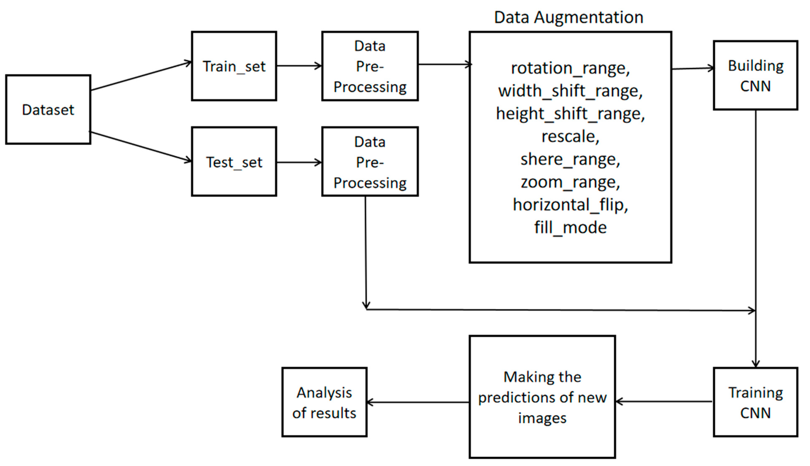
CLASS DIAGRAM

Slide 6
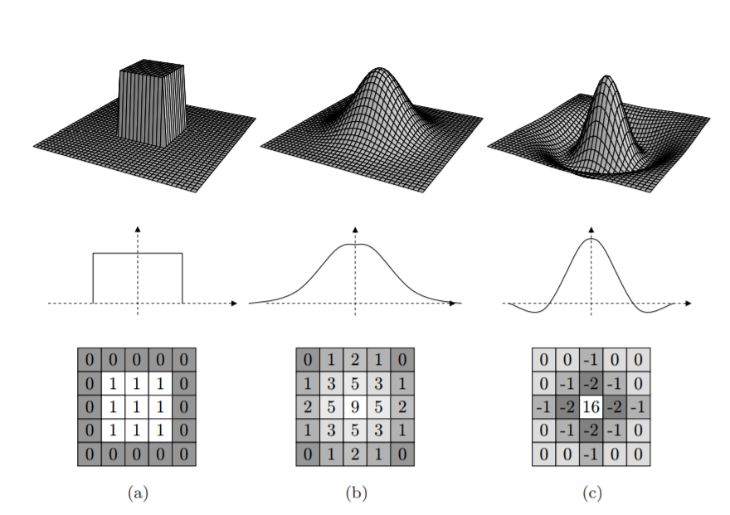
CLASSIFICATION USING KERAS

Slide 7
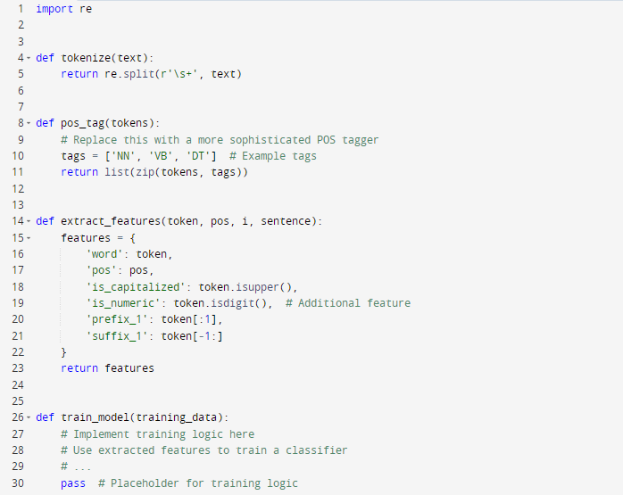
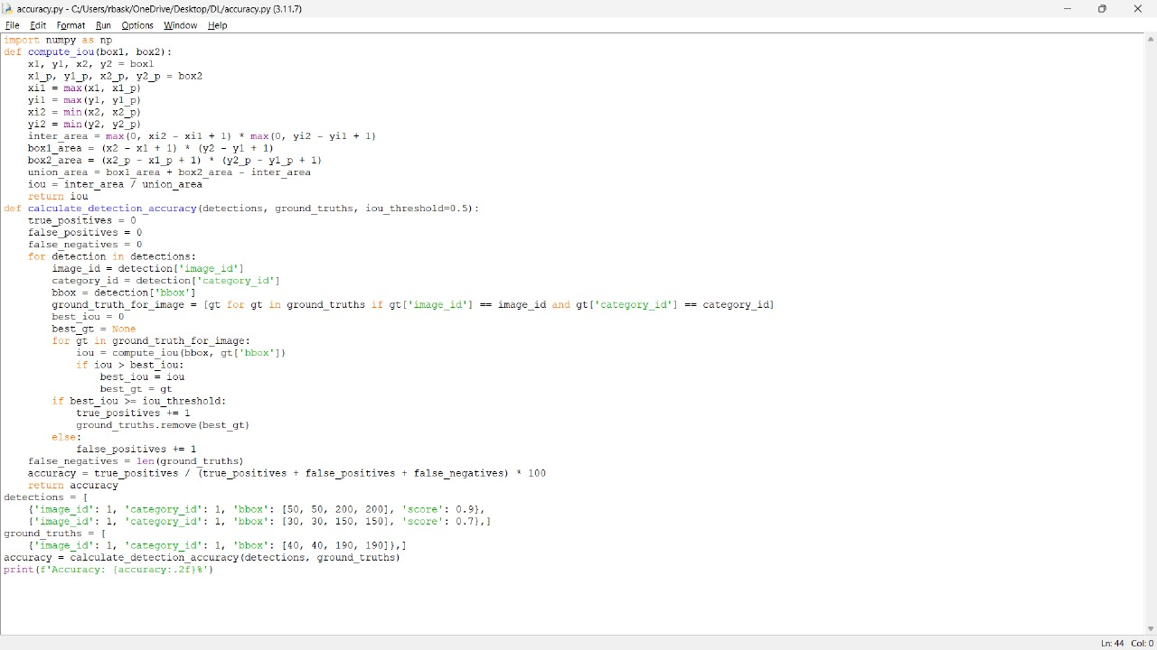
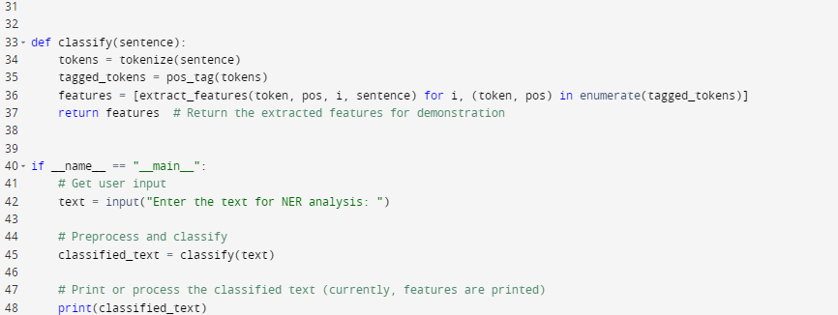
PYTHON CODE

Slide 8
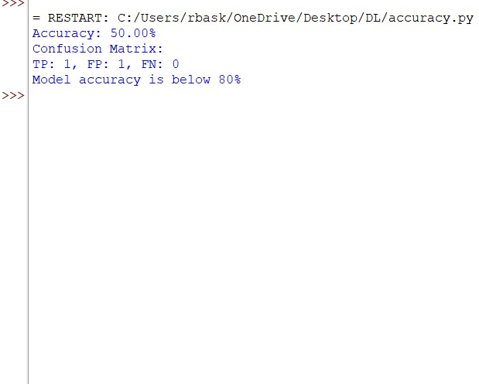
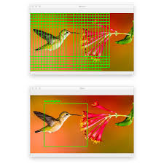
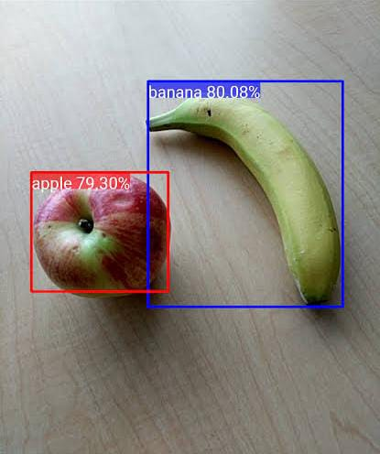
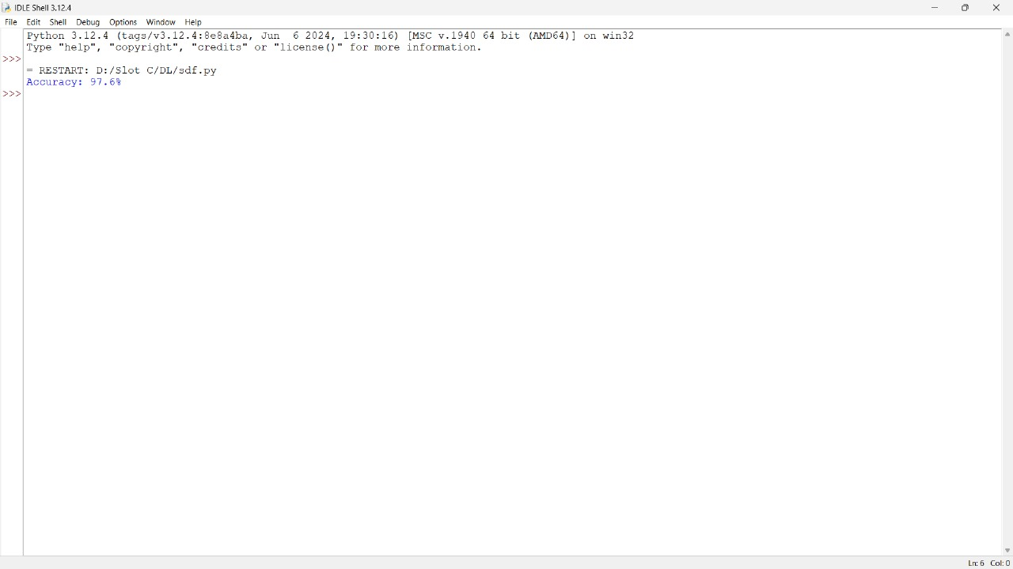
OUTPUT

Slide 9
ADVANTAGES
Automation: Object detection systems can automate tasks that were previously labour-intensive and time-consuming, such as image tagging, quality control, and surveillance.
Accuracy: With advancements in CNN architecture and training techniques, object detection models have achieved high accuracy, surpassing human performance in many cases.
Versatility: Object detection finds applications across various domains, including autonomous vehicles, medical image analysis, retail, agriculture, and security.
Real-time processing: Many object detection models can process images in real-time, enabling applications like video surveillance and augmented reality.

Slide 10
DISADVANTAGES
Computational Intensity: Requires powerful hardware like GPUs for training and running complex models. This can be costly and energy-intensive.
Data Dependency: Models heavily rely on large, diverse datasets for accurate performance. Acquiring and labelling such data can be time-consuming and expensive.
Real-time Challenges: Achieving real-time object detection in complex scenarios with many objects or occlusions remains a challenge.
Interpretability: Understanding the reasoning behind a model's decisions can be difficult, hindering trust and reliability in critical applications.

Slide 11
RESULT ANALYSIS
Object detection using CNNs has made significant strides, demonstrating high accuracy in locating and classifying objects within images.
These models excel at precise localization, handling multiple objects, and achieving real-time performance.
However, challenges such as detecting small objects, handling occlusions, and computational demands persist.
Ongoing research focuses on overcoming these limitations to expand the applicability of object detection across various domains.
The above used CNN model predicts the objects in the image with the accuracy of 91.60%

Slide 12
CONCLUSION
Object detection using Convolutional Neural Networks has emerged as a cornerstone in computer vision, revolutionizing how machines perceive and understand visual data.
By leveraging the power of CNNs to extract intricate features from images and combining them with advanced techniques, these models have achieved remarkable accuracy in locating and classifying objects within complex scenes.
This technology underpins a wide range of applications, from autonomous vehicles and surveillance systems to medical image analysis and augmented reality, promising to shape the future of human-computer interaction and industry.
Object detection models are highly data-dependent. Large, diverse, and accurately labeled datasets are essential for training robust models. Techniques like data augmentation and transfer learning can help mitigate the impact of limited data.

Slide 13
REFERENCES
Mansouri, Alireza, Lilly Suriani Affendey, and Ali Mamat. "Named entity recognition approaches." International Journal of Computer Science and Network Security 8.2 (2008): 339-344.
Mohit, Behrang. "Named entity recognition." Natural language processing of semitic languages. Berlin, Heidelberg: Springer Berlin Heidelberg, 2014. 221-245.
Sharnagat, Rahul. "Named entity recognition: A literature survey." Center For Indian Language Technology (2014): 1-27.
Mikheev, Andrei, Marc Moens, and Claire Grover. "Named entity recognition without gazetteers." Ninth Conference of the European Chapter of the Association for Computational Linguistics. 1999.
Goyal, Archana, Vishal Gupta, and Manish Kumar. "Recent named entity recognition and classification techniques: a systematic review." Computer Science Review 29 (2018): 21-43.

